Slide 1
Smart Digital Stethoscope
Phase II
TESTING
Group: sdmay22-18
Abdalla Alzaabi, Omar Alsaedi, Austin Collins, Matthew Gasparaitis, Yilun Huang, Joyce Lai, Vignati Yalamanchili

Slide 2
Unit Testing
Hardware
Oscilloscope
Check electrical signal associated with patients heartbeat
Bandpass filter
Check filtered electrical signal associated with patients heartbeat
ADC module
Check electrical signals
Bluetooth module
Check electrical signals
Author, Speaker – Austin Collins

Slide 3
Unit Testing (cont.)
Software
SQL
Make sure the data is storing properly
WebRTC
Make sure the data is being received/sent properly
Artificial Intelligence (AI)
Ensure the AI is outputting properly
Web App Navigation
Ensure the apps UI switches pages and is responsive
Author, Speaker – Austin Collins

Slide 4
Interface Testing
Oscilloscope → Bandpass filter
Bandpass filter → ADC module
ADC module → Bluetooth module
Bluetooth module → Web App
Web App → SQL
Web App → WebRTC
Web App → AI
SQL → Web App
Author, Speaker – Austin Collins

Slide 5
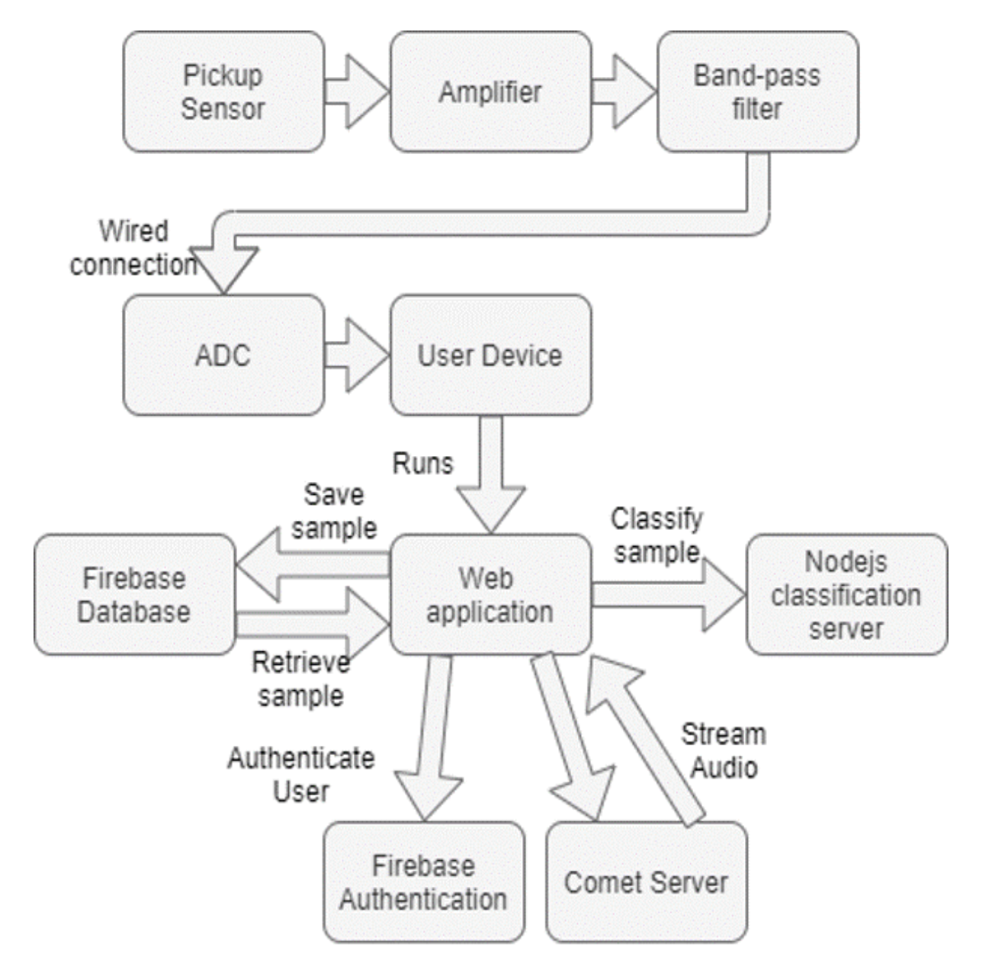
Integration Testing
Stethoscope, and initial microphone reading from stethoscope will have to be hooked up directly to the breadboard following previous phase’s work
Take initial oscilloscope frequency of unfiltered audio to use later
Frequency reading after going through the bandpass filter
Compare oscilloscope trace to initial results without filter
Hard-wired sound display
being connected to the last groups website(hopefully) will have to be compared to the bluetooth connectivity in order to verify we are picking up the correct range
WebRTC realtime and a secondary server containing audio recordings
Compare to initial hardwire frequencies as well, in order to determine whether we are transmitting enough of the correct frequencies needed. Then we will test with bluetooth as well.
Author, Speaker – Matthew Gasparitis

Slide 6
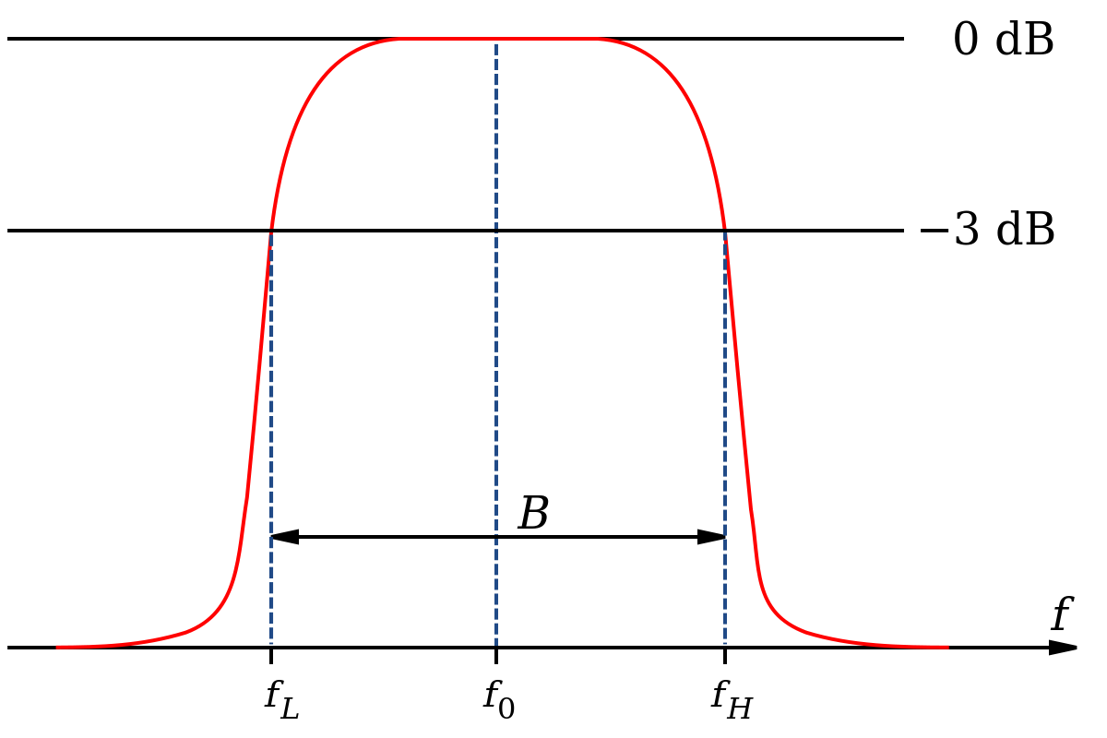
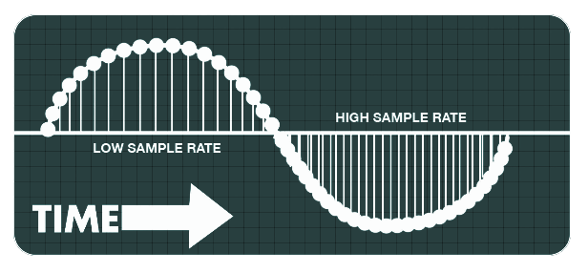
System Testing
System Tests Include
ALL unit, interface, and integration tests are imperative + overall system test.
Overall System Test
Main test vector – Coherence
Tool(s)
MATLAB, signal analysis functions (click for link)
PhysioNet database (click for link)
Compare
Validated patient data (from online database)
Data generated & transmitted by our system
Author, Speaker – Joyce Lai

Slide 7
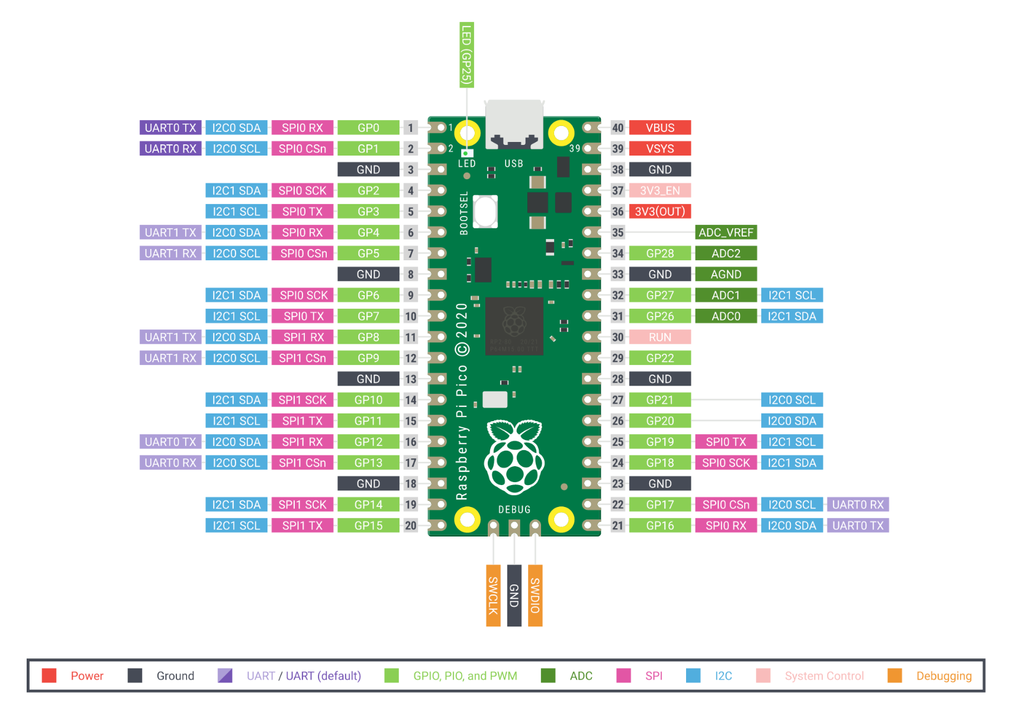
Regression Testing
By only run test cases that are relevant to the set of change can ensure the new additions not break the old functionality. We begin with critical systems and go to functional systems and then to non-functional systems. Also, we can set up Regression test tracking mechanism. This enables us to keep track of program modifications. If a software requires performance testing, we can conduct it. This test verifies the output's quality by evaluating the system and monitoring the system's response to feedback. As a whole, this procedure verifies that the system functions as expected by the customer. Additionally, it assesses the outcome in terms of user experience.
Author, Speaker – Yilun Huang

Slide 8
Acceptance Testing
Client's requirements met in our technical requirements (functional)
User-friendliness (non-functional)
Client test both medical professional and patient ’s side
Author, Speaker – Vignati Yalamanchili

Slide 9
Security Testing
The security for this project is not a challenging part since the details that will be shared in the Client - Server connection will be a sequence of audio files.
Since the majority of the project will be implemented using hardware (on breadboard, etc), if the Server-Client connection was secured, the only possible way to access the information will be through establishing a physical connection with the prototype.
For testing: Since the Client-Server will be using TCP connection, there will be a detection of packets not being acknowledged by the Server, meaning that their is either a connection error or other user receiving the data.
Author, Speaker – Abdalla Saeed Alzaabi

Slide 10
Results Testing*
TEST | CONCLUSION
Unit | - Each component functions properly, error propagation is minimal. - Data transmission and storage is successful. - Audio data accuracy is optimized.
Interface | - UI enables real-time streaming for multiple patient-doctor connections in parallel.
System | - Overall system meets all technical (functional) requirements.
Acceptance | - Overall system meets all non-technical requirements (non-functional) requirements (i.e. – user friendliness)
* Actual results will be collection in the second semester of our project.
Author, Speaker – Joyce Lai, Omar Alsaedi

Slide 11
Questions?
Thank you for your time!

