Slide 1
Smart Digital Stethoscope
Phase II
PROJECT PLAN
Group: sdmay22-18

Slide 2
Background
Heart-related illnesses and lung-related illnesses often occur suddenly. These illnesses are typically chronic and occur in individuals who are genetically predisposed or have records of related illnesses.
In the event of a health emergency, patients may not have the ability to get to an emergency room due to financial factors, day-to-day obligations, predetermined travel plans, and other factors. Additionally, patients may not even be aware of the severity of their health condition.
Likewise, doctors may not be physically present (in the office) at the time of their patient’s emergency due to similar factors. Also, the frequent relocation of healthcare workers is a common impediment to patients’ consistent care.

Slide 3
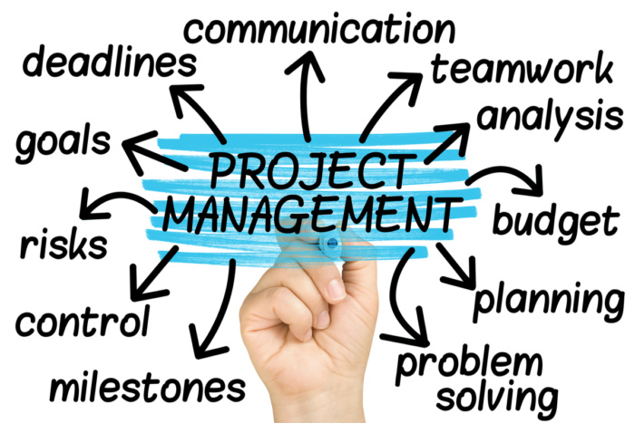
Project Management & Tracking Procedures
Project Management Style: Agile + Waterfall
Tracking Procedures
Git – Code sharing, software development-related tasks
Google Drive – Weekly meeting minutes, progress reports & individual tasks
Discord – Reiteration of meeting minutes, progress reports, individual tasks for accessibility

Slide 4
Task Decomposition (pt. 1)
For the Bluetooth functionality, there are multiple subtasks:
Identify requirements for sending our real-time patient data (i.e. – data rate, etc.).
Identify a suitable microcontroller and BT chip/module combination given our requirements.
Identify a suitable ADC chip/module to work with our analog signals and BT transmitter.
Connect and configure the microcontroller, ADC, BT chip/module.
For the WebRTC real-time patient data streaming server, there are also multiple subtasks:
Identify the structure of WebRTC and server setup.
Establish a server with 1 channel.
Enable automatic channel assignment for each user (patient or doctor).
Enable server GUI to only stream when both end-users have indicated they are ready.
Adapt the server to allow real-time streaming of audio files.
Enable two types of user accounts and corresponding login processes.

Slide 5
Task Decomposition (pt. 2)
For the final product with BT connectivity and WebRTC server, there are the following subtasks:
Build bandpass filter (BPF) prototype on breadboard. (Second order filter should be sufficient.)
Connect battery, stethoscope, microphone, and BPF, to ADC, microcontroller, and BT modules.
Configure server to take patient data readings after computer platform receives BT signal.
When BT connectivity and WebRTC are successfully integrated, replace BPF on breadboard with PCB design of BPF.
It should be noted that the BT connectivity and WebRTC development can be worked on in parallel.

Slide 6
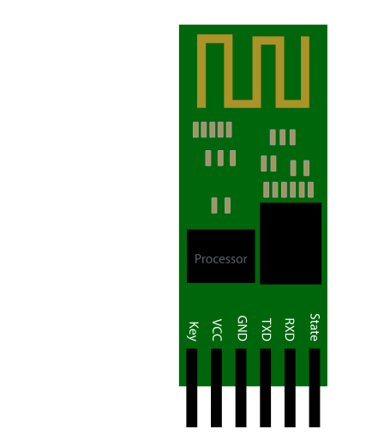
Proposed Milestones, Metrics, and Evaluation Criteria (pt. 1)
For the Bluetooth functionality, we have proposed the following milestones and metrics:
Hardware system (microcontroller, ADC, and BT modules) has sufficient data transfer and transmission rates for sending real-time stethoscope data.
Hardware system uses an appropriate amount of power (power equivalent to 3 AA batteries which previous team used).
Hardware system can capture sinusoidal signals at frequencies within the BPF range with gain of at least 0 dB (output/input magnitude = 1).
Hardware system nullifies irrelevant frequencies with change in gain of approximately -3dB (output/input magnitude = 1/2).
Hardware system have a good power efficiency.

Slide 7
Proposed Milestones, Metrics, and Evaluation Criteria (pt. 2)
For the WebRTC streaming server, we have proposed the following milestones and metrics:
Establish a server with 1 channel that can send and receive text messages with delay of less than 1µs.
Establish a server with multiple channels that can send and receive text messages with delay of less than 1µs.
Establish automatic channel assignment for each user (patient or doctor).
Establish server GUI that only streams when both end-users have indicated they are ready.
Establish real-time streaming of audio files with delay of less than 1µs.
Establish real-time streaming of real-time microphone audio input with delay less than 1µs.
Establish a server with two types of user accounts and corresponding login processes.

Slide 8
Timeline & Schedule

Slide 9
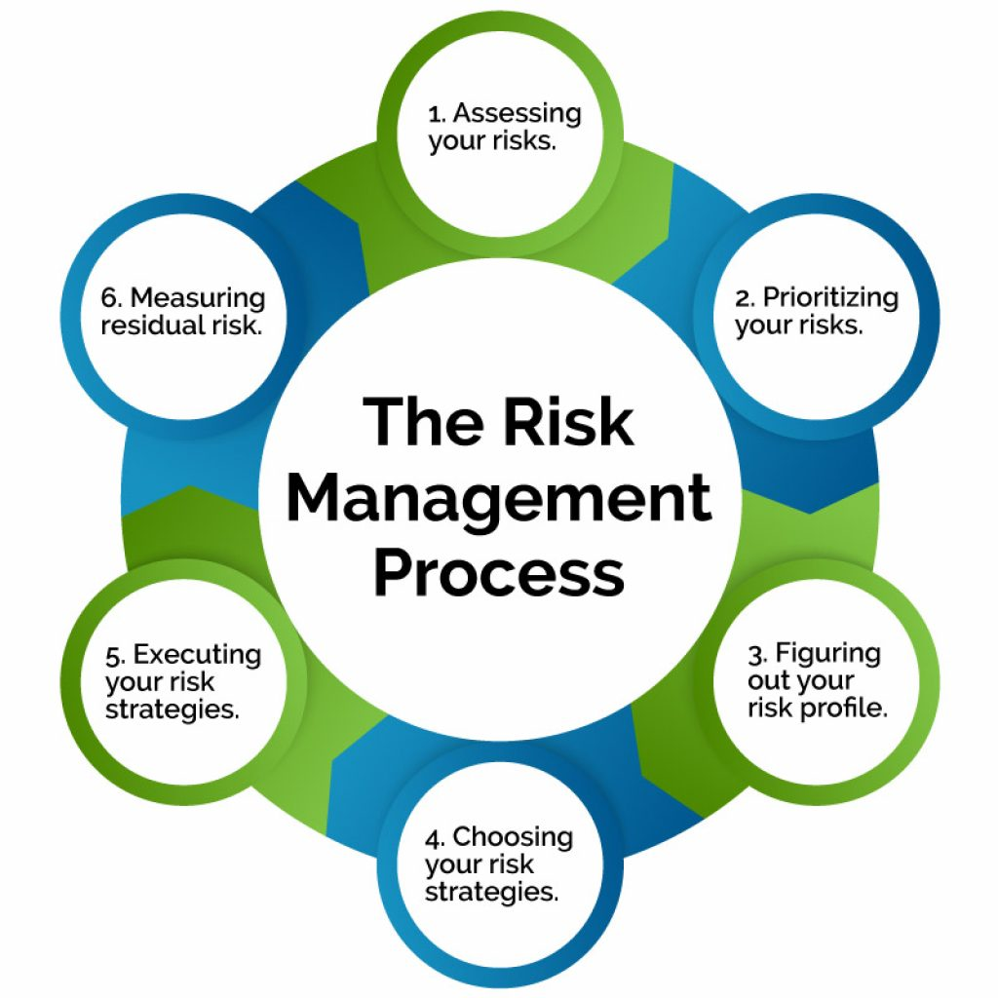
Risks And Risk Management/Mitigation
Scope Creep
Ensure clear boundaries in both our hardware and software designs so we do not do too much that is unnecessary or unwarranted.
Insufficient Testing
Ensure we are testing all of our work sufficiently prior to moving onto another part of the project.
Insufficient Resources
Ensure that we are purchasing the correct equipment so we do not squander our budget.

Slide 10
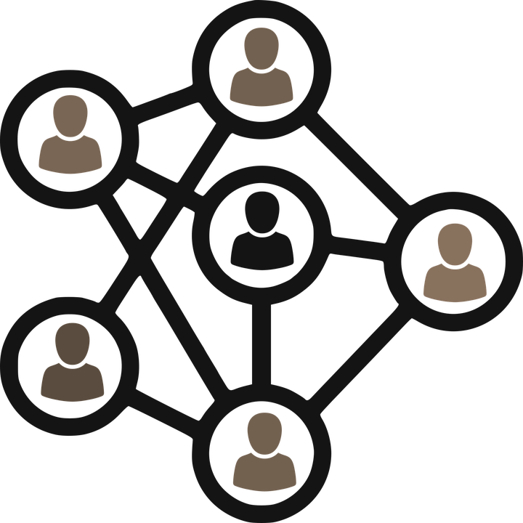
Personnel Effort Requirements
Task | Individual(s) Assigned | Est. Minimum Person - Hours Required to Complete Task | Explanation
Bandpass Filter Design | Matthew Gasparaitis, Joyce Lai, Yilun Huang | 20 min | Already done by previous group, just need to verify/adjust design as needed
Bluetooth Tx Research & Configuration with Microcontroller | Matthew Gasparaitis, Joyce Lai, Yilun Huang | 4 hrs | Will need to find a both cost-efficient and energy efficient chip that will transfer the needed number of packets, then we will need to install said device to the basic circuit
ADC Integration | Matthew Gasparaitis, Joyce Lai, Yilun Huang | 1 hr | Deciding on whether the ADC implementation will be on a breadboard or a software.
WebRTC Research & Initial Channel Testing | Austin, Abdalla, Omar | 2 hrs | Will need to decide if we are using Spring-boot or linux libraries to send the audio through IP addresses
WebRTC Integration | Austin, Abdalla, Omar | 1 hr | Will need to find a way to change the Server-Client connectivity from sending a String on chars to Audio files.
Testing | Joyce & Austin | 5 hrs | Will send out audio files/test the real time streaming to verify the usefulness of our finished stethoscope. However, testing throughout the design process is also required.

Slide 11
Other Resource Requirements
Previous group members’ contact information for potential technical guidance
Previous group’s hardware components
Previous group’s technical documentation (i.e. – schematic diagrams)
Bandpass filter: Breadboard(s), resistors, capacitors, operational amplifier(s), PCB designer and manufacturer, connection wires
Stethoscope (traditional, non-digital)
Microphone (that converts pressure waves to electrical signals)
Microcontroller (specific model TBD)
ADC module/chip (specific model TBD)
Bluetooth module/chip (specific model TBD)
Computer for system testing (on which we will pull up the WebRTC server and use as BT receiver)
Qualitative testing: Medical experts to evaluate accuracy of our digital audio.

Slide 12
Questions?
Thank you for your time!

