Slide 1
Smart Digital Stethoscope
Phase II
DESIGN
Group: sdmay22-18
Abdalla Alzaabi, Omar Alsaedi, Austin Collins, Matthew Gasparaitis, Yilun Huang, Joyce Lai, Vignati Yalamanchili

Slide 2
Design Context

Slide 3
Broader Context
SOCIETAL NEEDS | PROPOSED SOLUTION
• Regular monitoring of chronic heart or lung conditions • Instantaneous healthcare for emergencies • Increased physical access to healthcare • Consistent patient care • Affordable healthcare | • Digital heart and lung readings • Remote monitoring • Live streaming of patient data • Cheaper smart digital stethoscope than current commercial products

Slide 4
User Needs
USER GROUP | HOW THEY WILL BENEFIT
Low income communities | • Reduced cost • Increased affordability
Small, rural communities | • Increased accessibility
Patients with chronic heart or lung conditions | • Increased accessibility • Remote and continuous monitoring
Healthcare workers, medical professionals | • Reduced need for in-person appointments • Increased quality of healthcare
Everyone | • Increased convenience

Slide 5
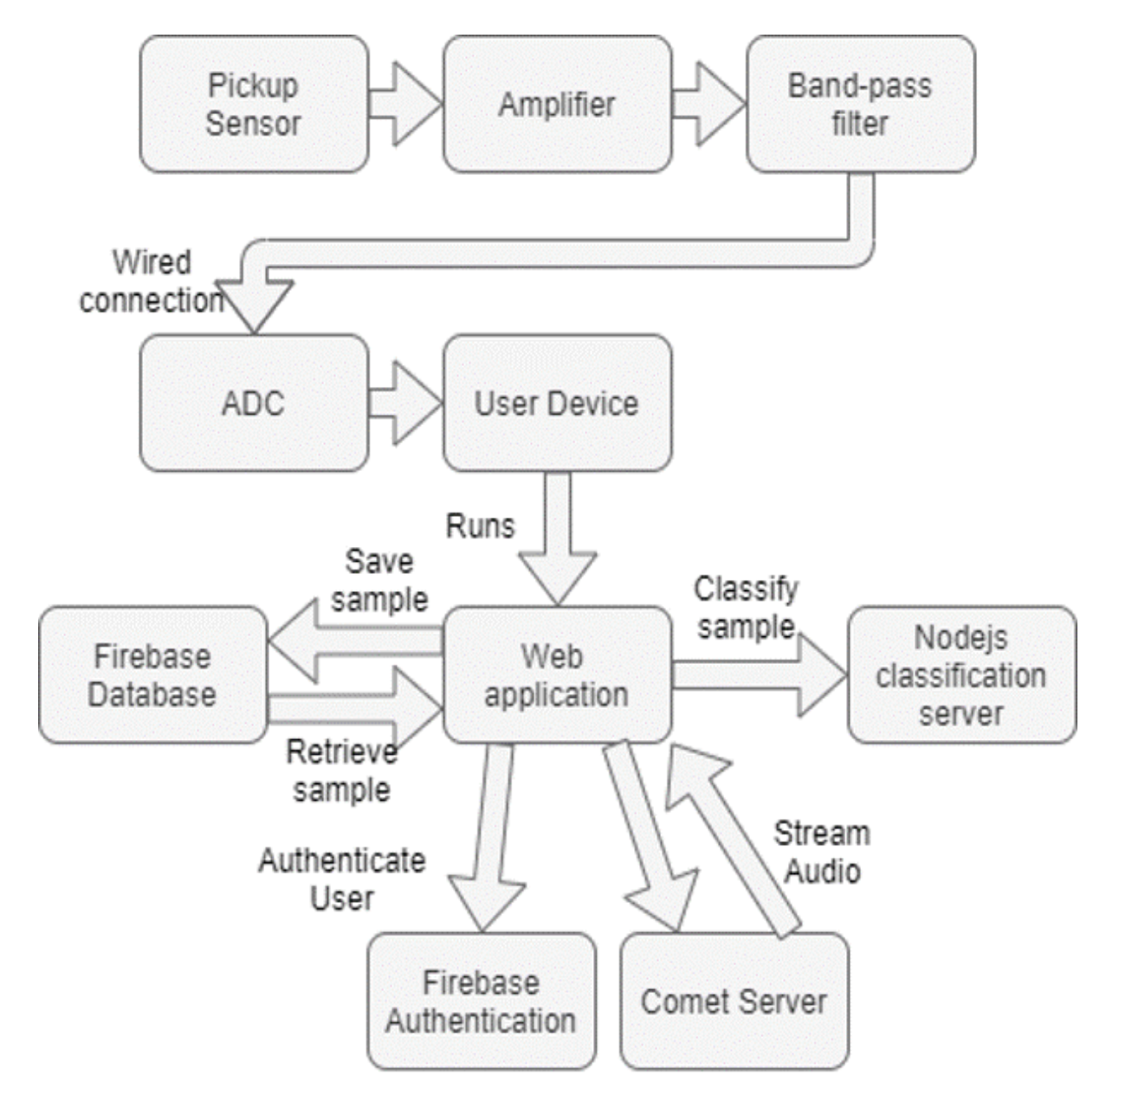
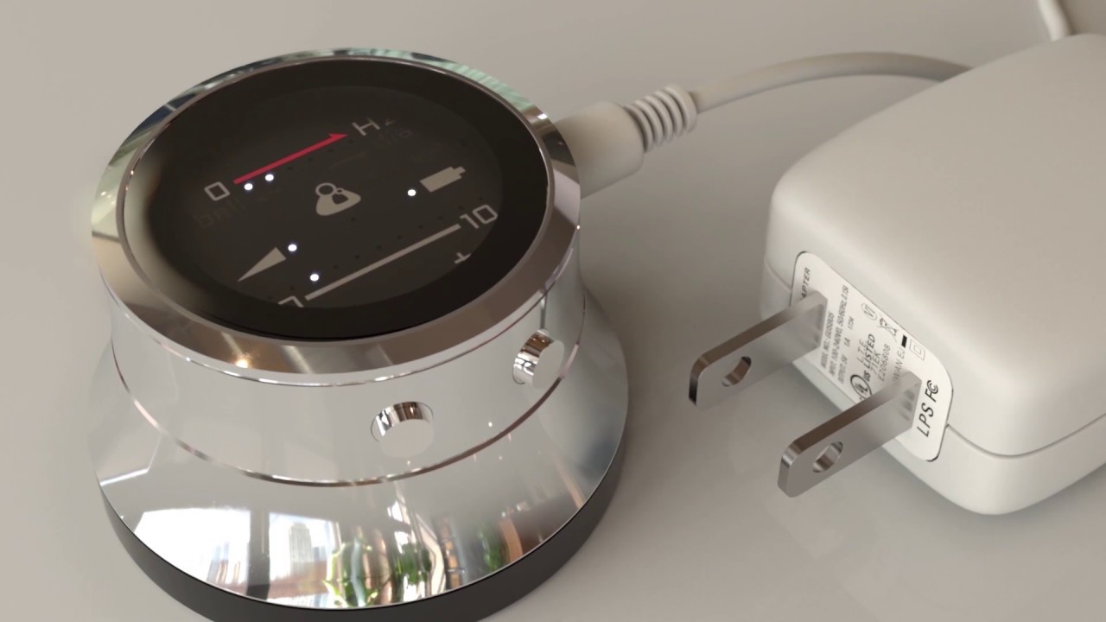
Prior Work & Solutions
Smart Digital Stethoscope – Phase I
Phase I Successfully Achieved
Noise cancelling filter
Pressure waves → analog electrical signals → digital signals (audio data) via wired connection
Existing Technologies
Eko CORE Digital Attachment ($249)
Thinklabs One Digital Stethoscope ($499)

Slide 6
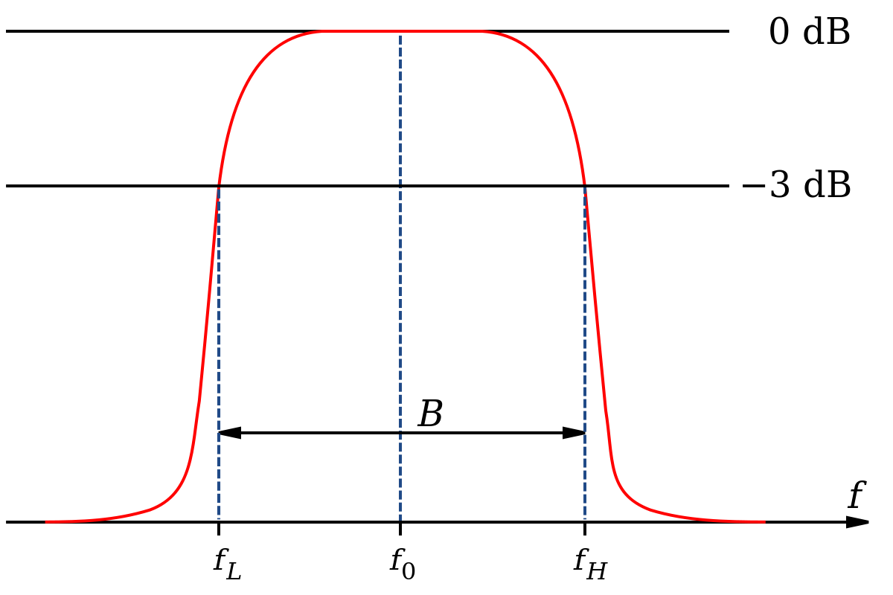
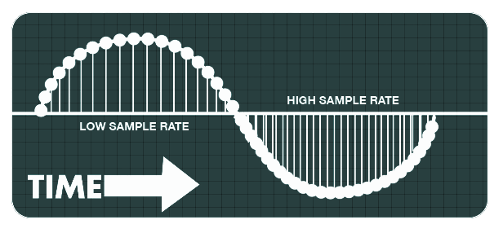
Technical Complexity
Engineering Principles Required
Analog filter design and implementation
Analog-to-Digital Converter (ADC)
Microcontroller and submodules (BT, ADC) configuration & initialization
UART
Bit and baud rate
Sampling rate
Web server and network architecture
Effective data storage
PCB design
CAD and 3D printing

Slide 7
Design Exploration

Slide 8
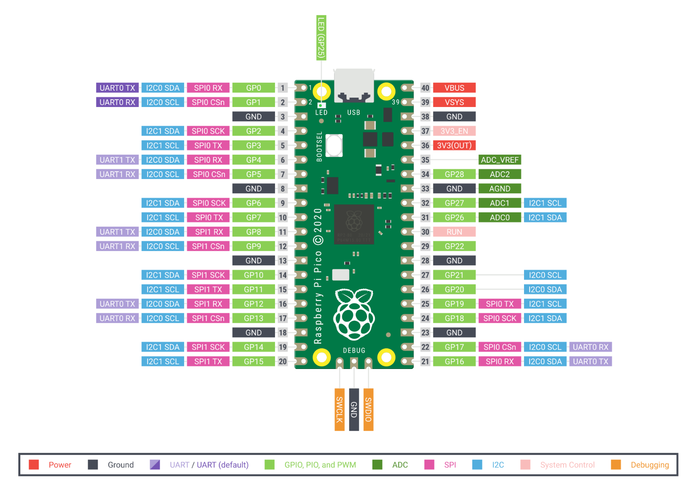
Design Decisions & Ideation
Microcontroller – Raspberry Pi Pico
Microphone – Adafruit MAX9814
Filter – Analog Bandpass filter
ADC module – Raspberry Pi Pico
BT chip – TBD
* Design decisions are subject to change as progress continues.

Slide 9
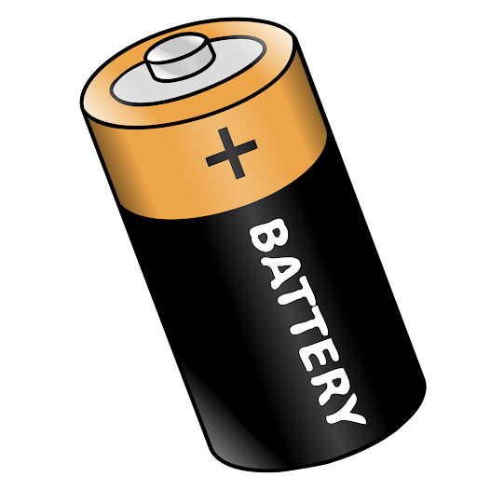
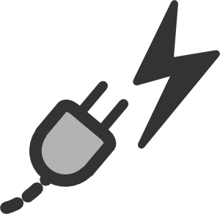
Decision Making & Trade-Offs
Power and Cost Efficiency v. Increased User Friendliness
Phase I design only used 3 AAA batteries
Bluetooth-integrated Microcontroller v. Separate Microcontroller and BT chip
Phase I design was not successful using BT-integrated microcontroller
Real-time Communication v. Server Overhead
Phase I design did not attempt much real-time streaming work

Slide 10
Proposed Design

Slide 11
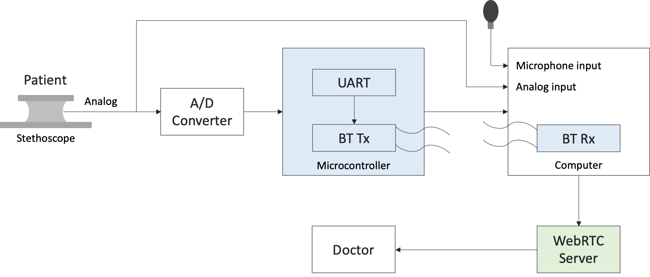
Design Visual & Description

Slide 12
Functionality
1
Patient turns on smart digital stethoscope
2
Patient measures heart beat or lung contraction
3
Automatic real-time data TX via BT to CPU
4
Automatic real-time data streaming to server via Wi-Fi
5
Doctor is notified and listens to audio stream

Slide 13
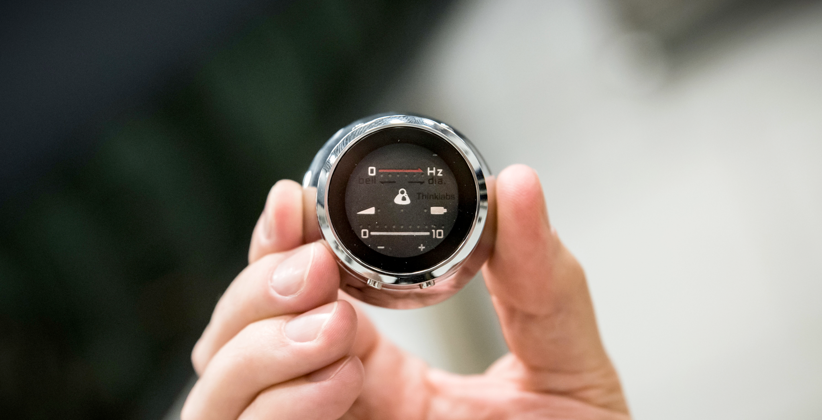
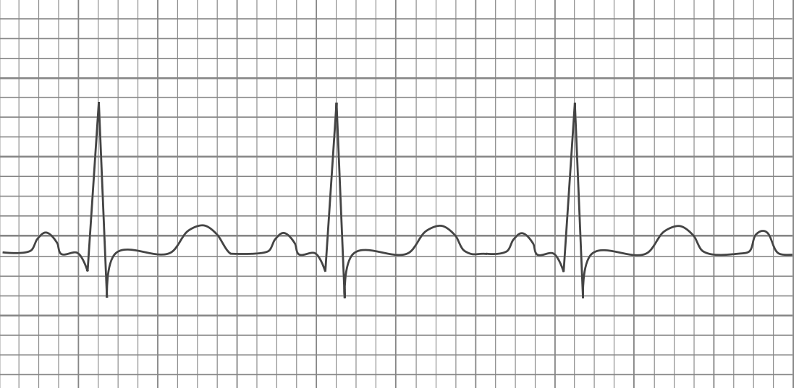
Areas of Concern & Development
Primary Focuses
Making it compact and into one unit.
Keeping the “look” of a stethoscope.
Secondary Focuses
Machine learning algorithm to help detect and categorize patterns (i.e. – Heart murmurs, tachycardia, etc.)
Security and privacy concerns for patient data storage (HIPAA approved).
Making sure patients with chronic illnesses take responsibility in taking their measurements.

Slide 14
Questions?
Thank you for your time!

